Slide 1
New student in the town!!!

Slide 2
Introduction
“Are you a student in a certain university and live nearby?!”
“Are these question familiar to you?!” :
“From where can I buy food?!”
“Where is the nearest shop”
“What is the most rated restaurant around”

Slide 3
Our Code in the github is something that you need to
try when ever you are transferring to a new university
and wants to discover what are the possibilities available
to you

Slide 4

Foursquare is the solution that we found for
locating different corner of the world!

Slide 5
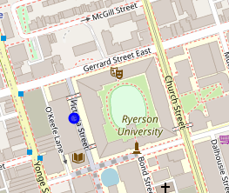
For step is to identify the dorms of the university as follow:

Slide 6
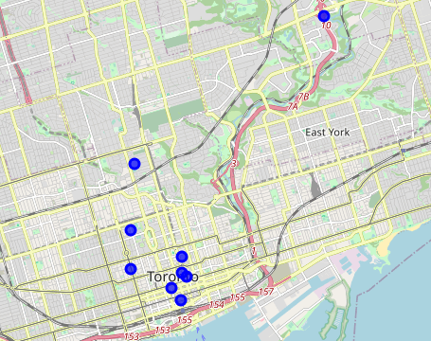
Secondly, identify all of the places of interest without specifying, as follow:

Slide 7
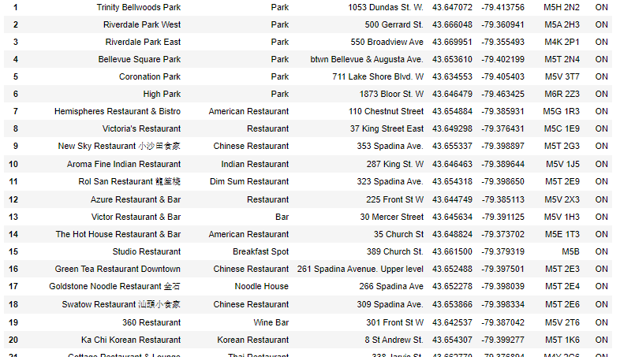

Slide 8
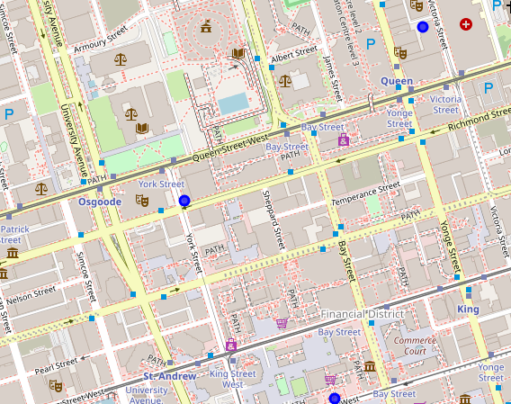
We take for example the following results of nearest Cinemas:

Slide 9
Foursquare is a powerful tool that enables us to build a robust algorithm of our desire and generalize it all over the world, a good example was the life of a student especially a newcomer that want to discover the different places in the town. The project will be public and can be used by all the students all over the world easily.
Conclusion

